Slide 1
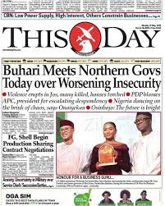
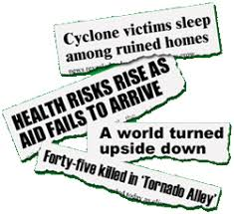
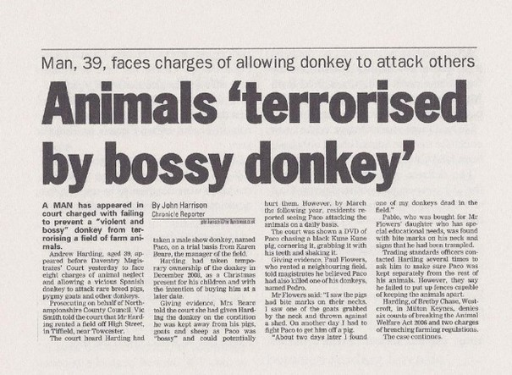
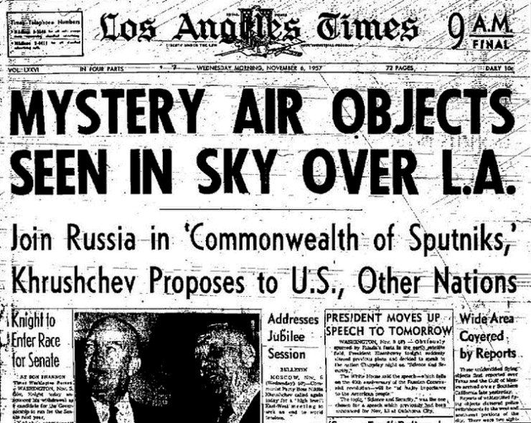
News
M

Slide 2
News Values
News values are "criteria that influence the selection and presentation of events as published news". These values help explain what makes something "newsworthy". Initially labelled "news factors", news values are widely credited to Galtung and Ruge

Slide 3
News Elements
The concepts that make News a News.
Objectivity ( Unbiased, Free from propaganda,exeggeration)
Truthfulness (Based on Facts, misinformation, Disinformation)
Freshness ( Timeliness

Slide 4
Definitions
The term News comes from the word New. In modern day it is considered as acronym for the four sides of the world. North, East, West and South

Slide 5
Continued
The term has evolved to it’s present form with the progress of journalism
Current ,accurate and complete information, focused on daily matters and personalized (human interest story) Penny Press
Objective and based on fact information. Associated press (1848)

Slide 6
Continued
“News is when a man bites a dog”
It is sensational
It presents an event which is extraordinary, unusual and atypical.
It reveals the extraordinary character of human nature

Slide 7
Robert E Park (1940)
Walter Lippman (1922) was the first man who saw the news as a product of standardized procedures and journalist routine
“News is something new, but it ages quickly”
News is something unexpected and it talks about something extraordinary and unanticipated. If an event is to become news it must be publicized

Slide 8
Royal Commission on the press (1949)
In order for an event to be news, it needed to meet the following conditions
It must be new and interesting to the public, that is B about people and their various strange or funny experiences, tragedies, accidents, crime or sport events

Slide 9
Nancy Hicks (1960s)
Something which is new, weird, vivid and unexpected

Slide 10
Fred Morris
News is “What is current, important and influences our lives”

Slide 11
Mark Henderson
News by definition involves unexpected and dramatic, not the run of the mill

